Slide 1
Process Layout
Karthik Dantu
Ethan Blanton
Computer Science and Engineering
University at Buffalo
kdantu@buffalo.edu

Slide 2
Code → Executable → Process
C source code
C statements organized into functions
Stored as a collection of files (.c and .h)
Executable module
Binary image generated by compiler
Stored as a file (e.g., a.out)
Process
Instance of a program that is executing
With its own address space in memory
With its own id and execution state
Managed by the operating system
C source code
compiling
executable
running
process

Slide 3
Process Execution
What is virtual memory?
Contiguous addressable memory space for a single process
May be swapped into physical memory from disk in pages
Let’s you pretend each process has its own contiguous memory
0
Virtual
Address
Space
Network
Audio
CPU
Data Bus
32
32
Disk
Video
Memory
0xffffffff

Slide 4
What to Store: Code and Constants
Executable code and constant data
Program binary, and any shared libraries it loads
Necessary for OS to read the commands
OS knows everything in advance
Knows amount of space needed
Knows the contents of the memory
Known as the “text” segment
Note: Some systems (e.g., hats) store some constants in “rodata” section
0
Text
0xffffffff

Slide 5
What to Store: “Static” Data
Variables that exist for the entire program
Global variables, and “static” local variables
Amount of space required is known in advance
Data: initialized in the code
Initial value specified by the programmer
E.g., “int x = 97;”
Memory is initialized with this value
BSS: not initialized in the code
Initial value not specified
E.g., “int x;”
All memory initialized to 0 (on most OS’s)
BSS stands for “Block Started by Symbol”
0
Text
Data
BSS
0xffffffff

Slide 6
What to Store: Dynamic Memory
Memory allocated while program is running
E.g., allocated using the malloc() function
And deallocated using the free() function
OS knows nothing in advance
Doesn’t know the amount of space
Doesn’t know the contents
So, need to allow room to grow
Known as the “heap”
Detailed example in a few slides
More in programming assignment #4
0
Text
Data
BSS
Heap
0xffffffff

Slide 7
What to Store: Temporary Variables
Temporary memory during lifetime of a function or block
Storage for function parameters and local variables
Need to support nested function calls
One function calls another, and so on
Store the variables of calling function
Know where to return when done
So, must allow room to grow
Known as the “stack”
Push on the stack as new function is called
Pop off the stack as the function ends
Detailed example later on
0
Text
Data
BSS
Heap
Stack
0xffffffff

Slide 8
Memory Layout: Summary
Text: code, constant data
Data: initialized global & static variables
BSS: uninitialized global & static variables
Heap: dynamic memory
Stack: local variables
0
Text
Data
BSS
Heap
Stack
0xffffffff

Slide 9
Memory Layout: Example
char* string = “hello”;
int iSize;
char* f(void)
{
char* p;
iSize = 8;
p = malloc(iSize);
return p;
}
0
Text
Data
BSS
Heap
Stack
0xffffffff

Slide 10
Memory Layout: Example
char* string = “hello”;
int iSize;
char* f(void)
{
char* p;
iSize = 8;
p = malloc(iSize);
return p;
}
0
Text
Data
BSS
Heap
Stack
0xffffffff

Slide 11
Memory Layout: Data
char* string = “hello”;
int iSize;
char* f(void)
{
char* p;
iSize = 8;
p = malloc(iSize);
return p;
}
0
Text
Data
BSS
Heap
Stack
0xffffffff

Slide 12
Memory Layout: BSS
char* string = “hello”;
int iSize;
char* f(void)
{
char* p;
iSize = 8;
p = malloc(iSize);
return p;
}
0
Text
Data
BSS
Heap
Stack
0xffffffff

Slide 13
Memory Layout: Heap
char* string = “hello”;
int iSize;
char* f(void)
{
char* p;
iSize = 8;
p = malloc(iSize);
return p;
}
0
Text
Data
BSS
Heap
Stack
0xffffffff

Slide 14
Memory Layout: Stack
char* string = “hello”;
int iSize;
char* f(void)
{
char* p;
iSize = 8;
p = malloc(iSize);
return p;
}
0
Text
Data
BSS
Heap
Stack
0xffffffff

Slide 15
Memory Allocation and De-allocation
How, and when, is memory allocated?
Global and static variables: program startup
Local variables: function call
Dynamic memory: malloc()
How is memory deallocated?
Global and static variables: program finish
Local variables: function return
Dynamic memory: free()
All memory deallocated when program ends
It is good style to free allocated memory anyway
0
Text
Data
BSS
Heap
Stack
0xffffffff

Slide 16
Memory Allocation Example
char* string = “hello”;
int iSize;
char* f(void)
{
char* p;
iSize = 8;
p = malloc(iSize);
return p;
}
Data: “hello” at startup
BSS: 0 at startup
Stack: at function call
Heap: 8 bytes at malloc

Slide 17
Memory Deallocation Example
char* string = “hello”;
int iSize;
char* f(void)
{
char* p;
iSize = 8;
p = malloc(iSize);
return p;
}
Available till termination
Available till termination
Deallocate on return from f
Deallocate on free()

Slide 18
Aside: Using Sections
The exact addresses of sections will vary
However, you can usually assume certain things
We’ll look at some of those properties later
Learning to recognize the location of a pointer is valuable
For example: all pointers < 4096 (0x1000) are invalid!

Slide 19
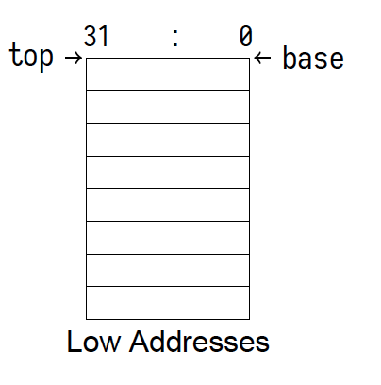
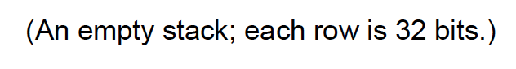
Stack Operations

Slide 20
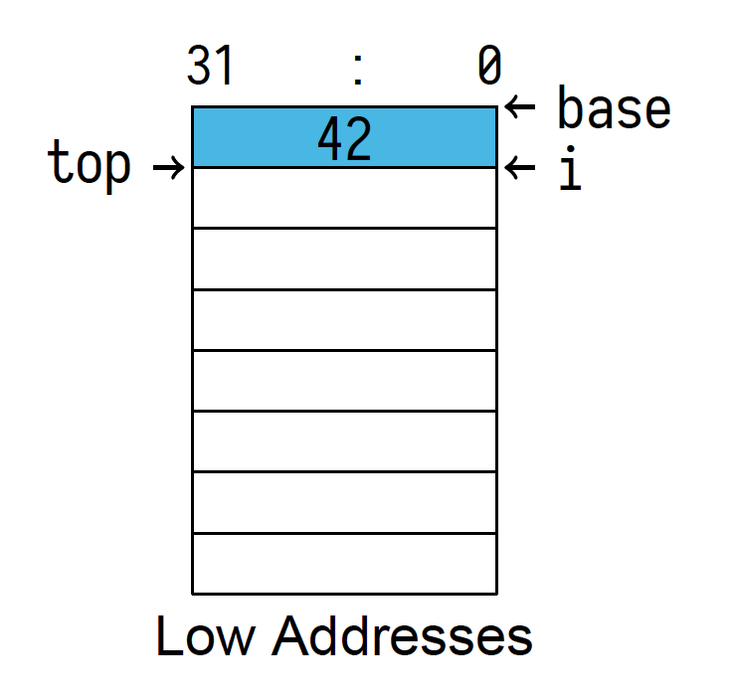
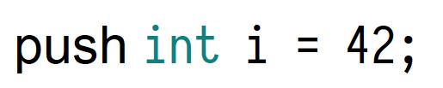
Stack Operations

Slide 21
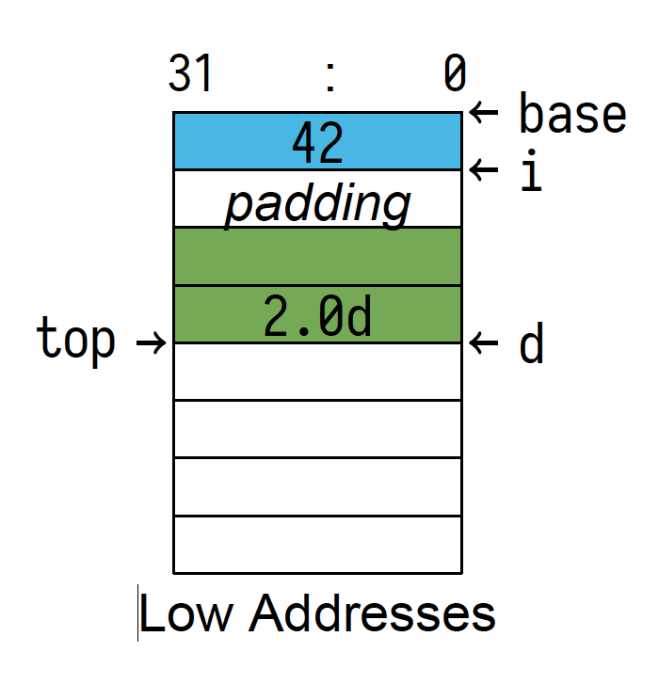
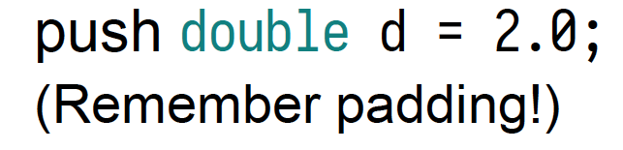

Slide 22
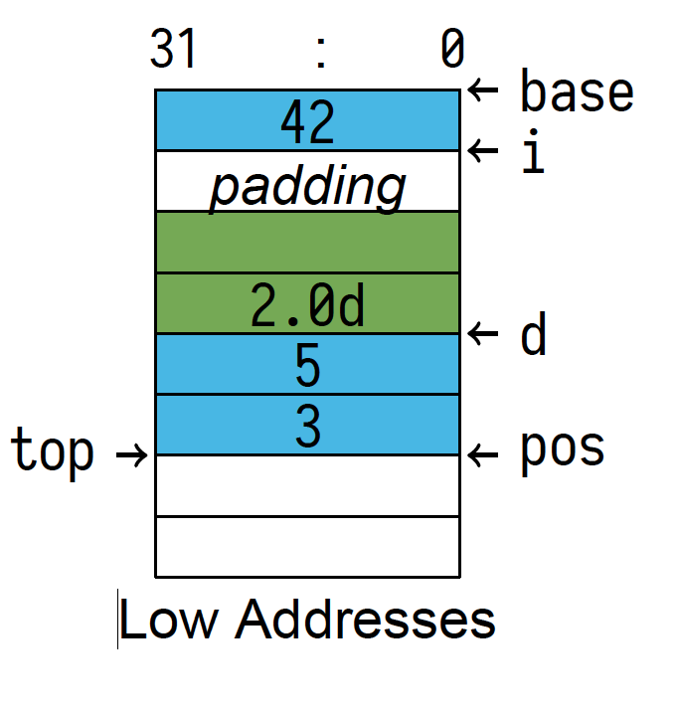
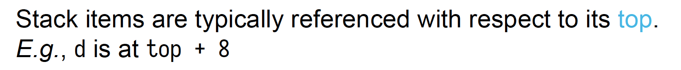

Slide 23
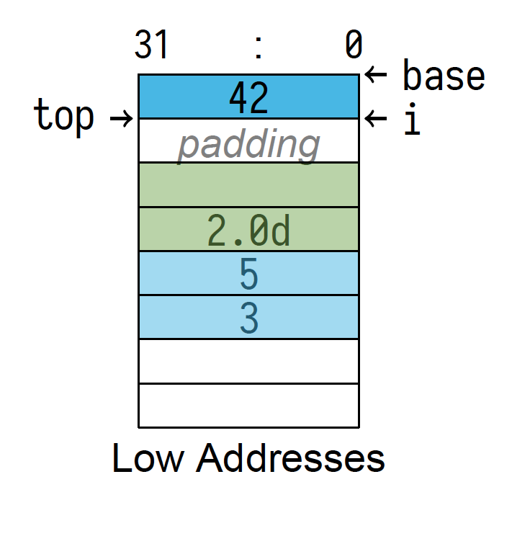

Slide 24
Variable Declarations
A variable does two things
Ask compiler to reserve memory for data
Name the location of that data
“Make space for 32 integers and call that space array
Every non-static, local variable is an automatic variable
int array[32];

Slide 25
Automatic Variable Lifetime
Automatic variables are:
Guaranteed to be allocated before they are first referenced
Guaranteed to be valid until their enclosing block is done
In many cases they are created when the function is entered
Placing automatic variables on the stack allows this

Slide 26
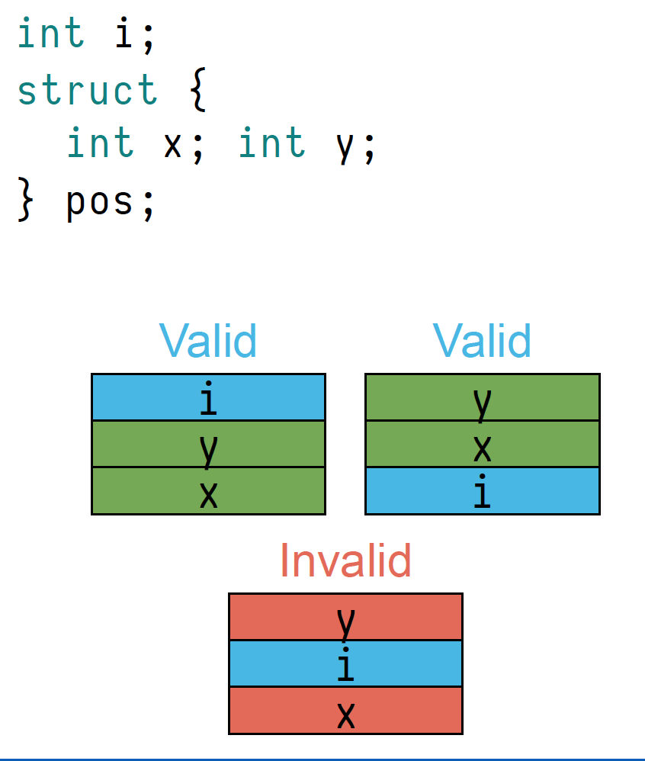
Automatic Variable Placement
Automatic variables may be allocated anywhere
The programmer cannot predict their order or location
They may only be in registers!
Their structure will be preserved

Slide 27
Function Call Nesting
Note that:
Function calls form a tree over the life of a program
Function calls form a stack at any point in time
This is because:
A function may call many functions consecutively
A function can call only one function at a time
These properties directly affect the program stack

Slide 28
Function Calls
At its simplest, a function call consists of:
A jump to a new program location
Execution of the function code
A jump back to the calling location
However, many function calls are more complicated. They may:
Allocate automatic variables
Call other functions
Temporarily save registers
…
In these cases, functions require a stack frame.

Slide 29
Stack Frames
A stack frame holds information for a single function invocation.
While the details vary by platform, it will include:
Saved processor registers
Local variables for the current function
Arguments for any called function
The return location for any called function
We will discuss all of these except saved processor registers.
(Maybe we’ll get to those later.)

Slide 30
Local Variables
We have previously discussed automatic variables.
Often, all local variables for a function are allocated together.
When the function is entered, it will immediately move the top of the stack to make room for its local storage.
This portion of the stack frame is then of fixed size.
Its size is often not saved, but recorded in the program instructions by the compiler.
The location of individual variables are likewise recorded.

Slide 31
Function Arguments
The platform ABI will determine how arguments are passed
Normally, it is a combination of registers and stack space
On x86-64 Linux, the first six 64 bit values are passed in
registers
Any additional arguments are pushed onto the stack
Therefore, many functions have no arguments on the stack

Slide 32
Function Arguments Layout
If function arguments are pushed onto the stack, they are normally pushed in reverse order
That is, the first function argument is closest to the top
Among other reasons, this allows for a variable number of arguments
Consider printf: it takes 1 or more arguments
The first format argument tells it how many

Slide 33
The Program Counter
The other major item that must be tracked for the function call stack is the program counter
The program counter is the address of the machine instruction the processor is currently executing
For a function call:
the current program counter is pushed before jumping to the called function
the called function pops the program counter in order to return
On some architectures there is a dedicated instruction for this

Slide 34
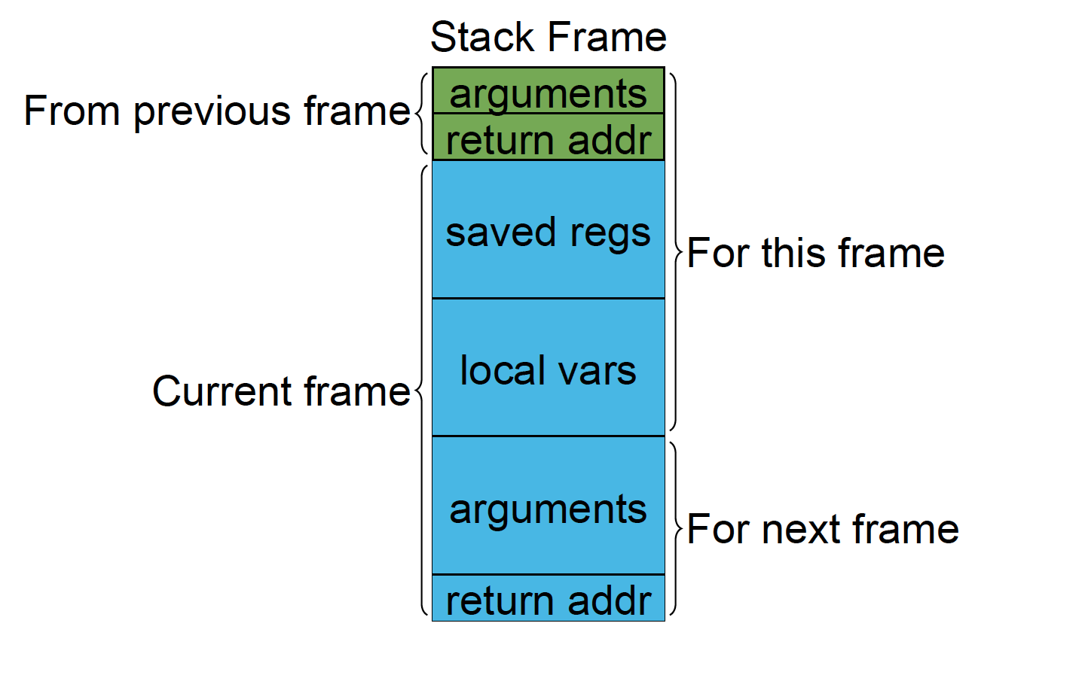
A stack frame

Slide 35
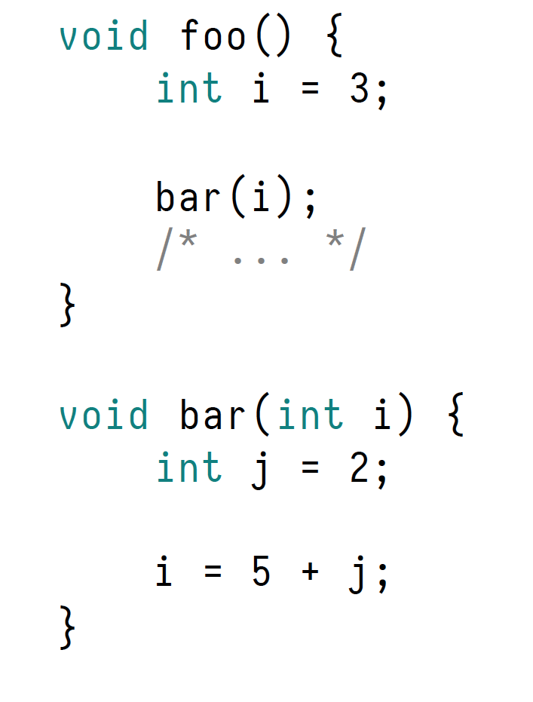
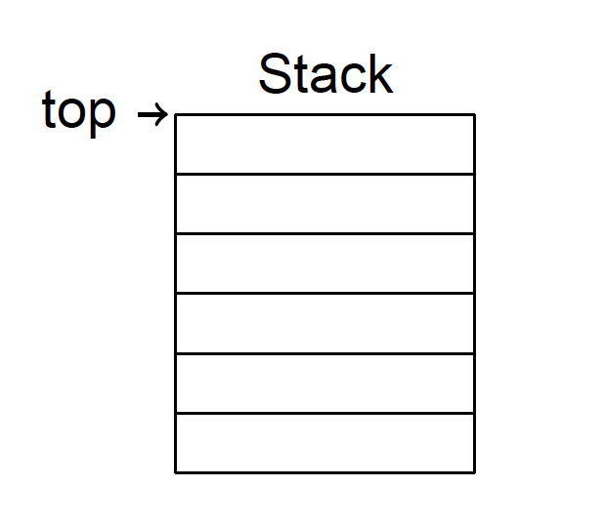
Stack Frame: Example

Slide 36
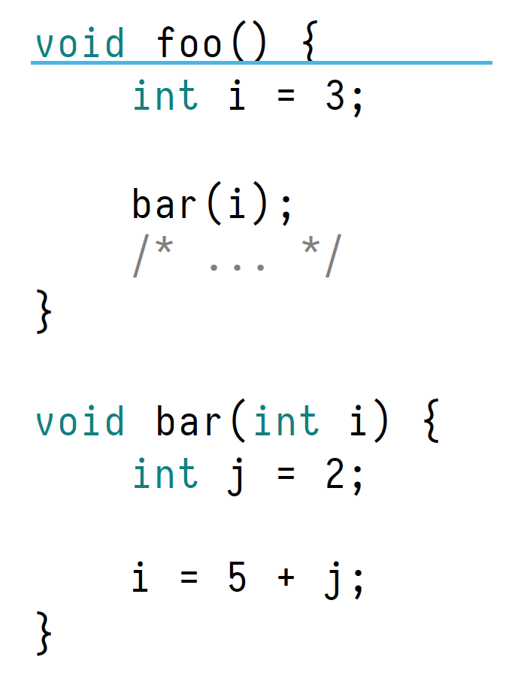
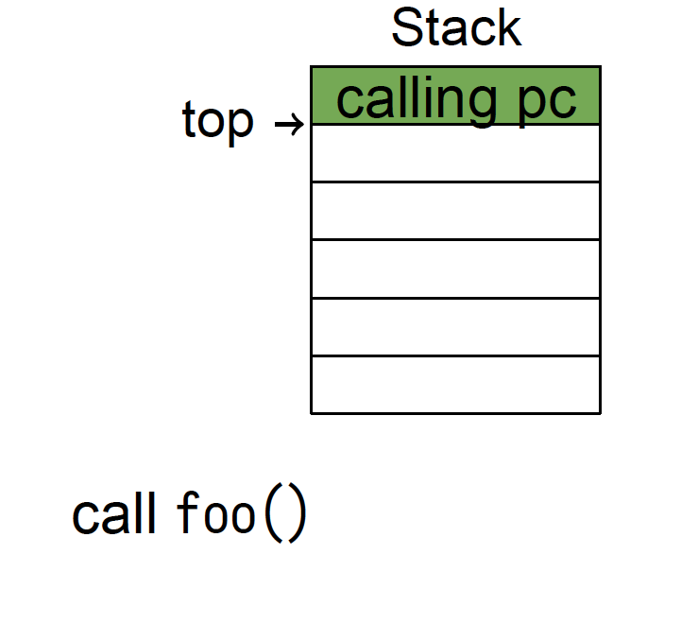
Stack Frame: Example

Slide 37
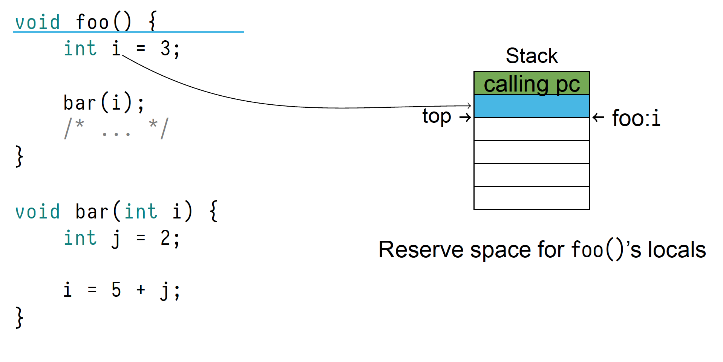
Stack Frame: Example

Slide 38
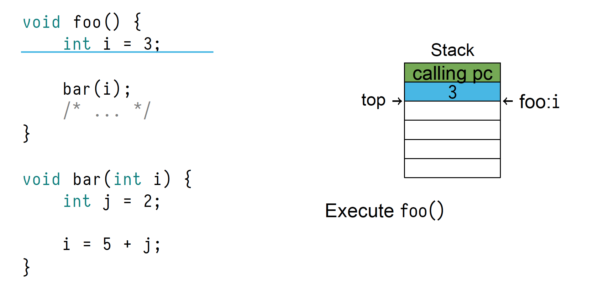
Stack Frame: Example

Slide 39
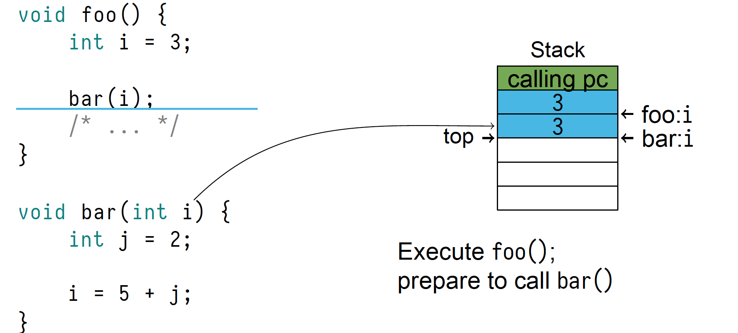
Stack Frame: Example

Slide 40
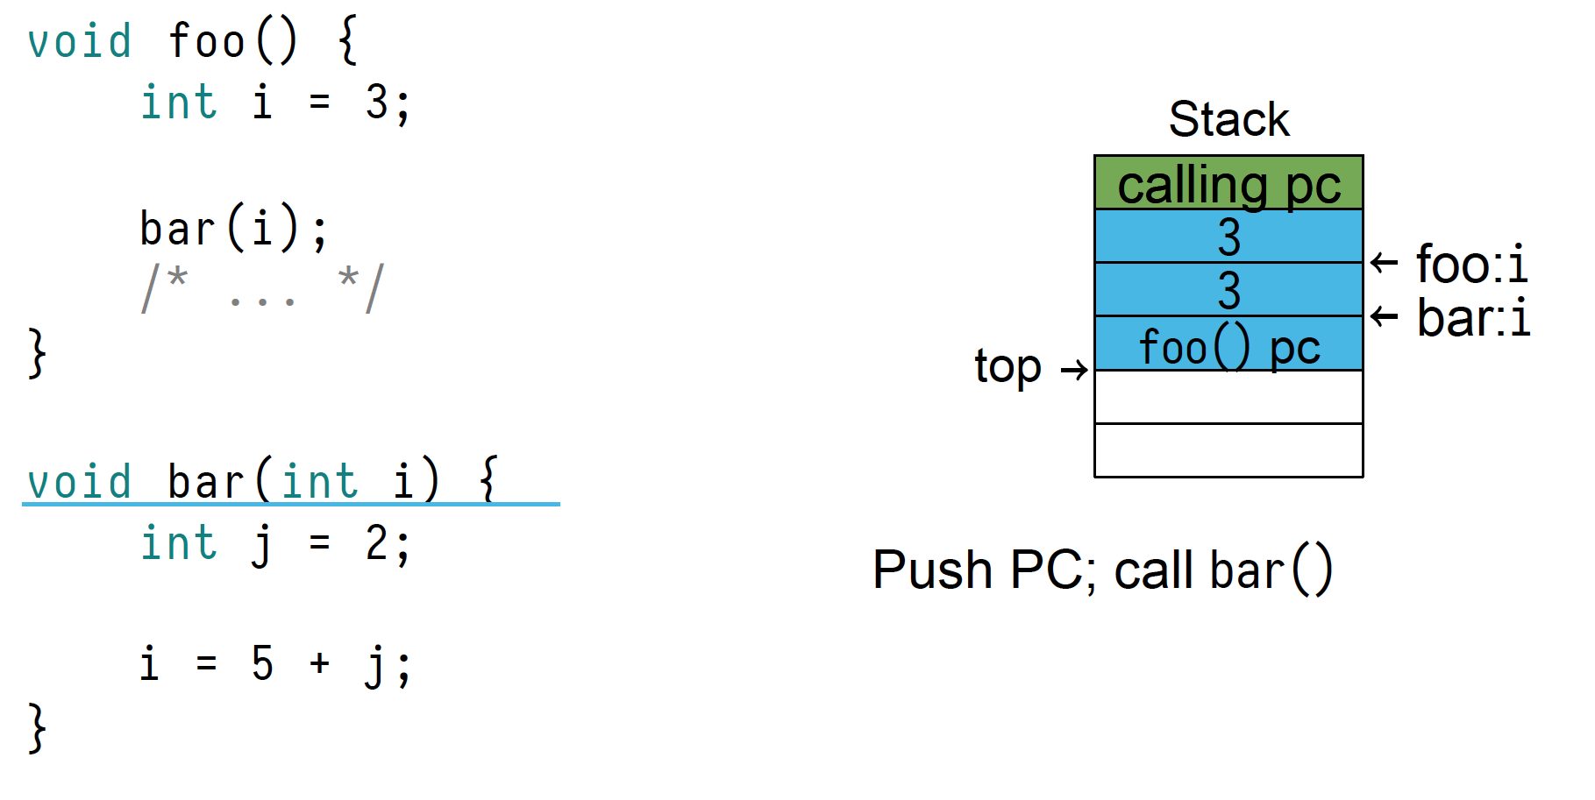
Stack Frame: Example

Slide 41
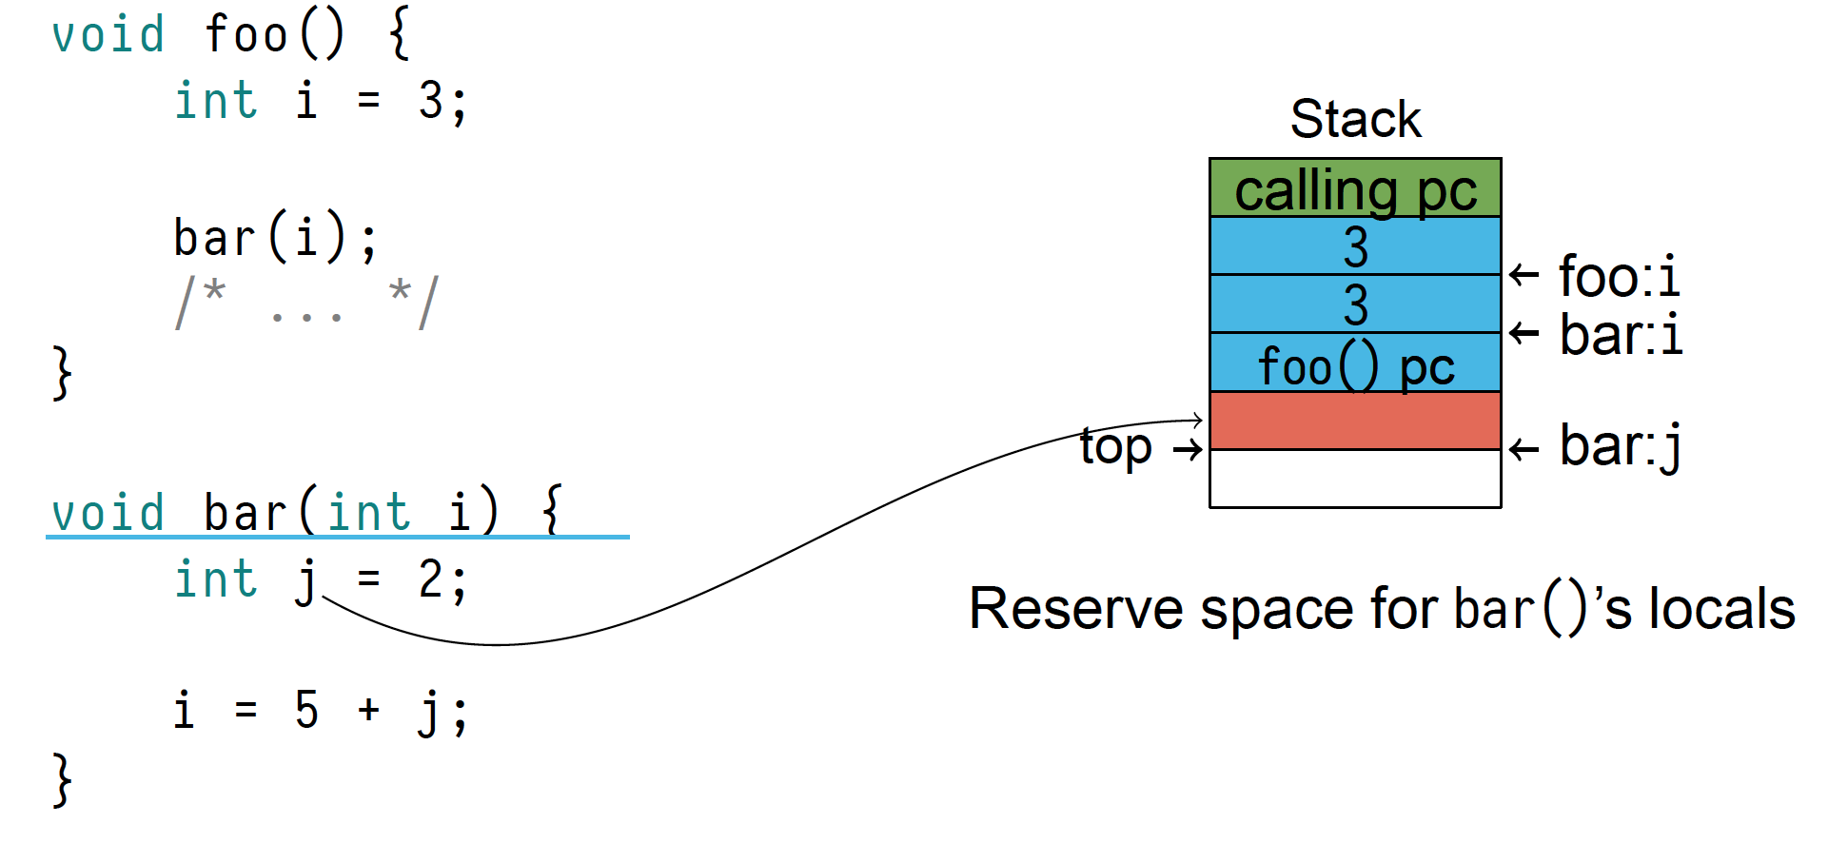
Stack Frame: Example

Slide 42
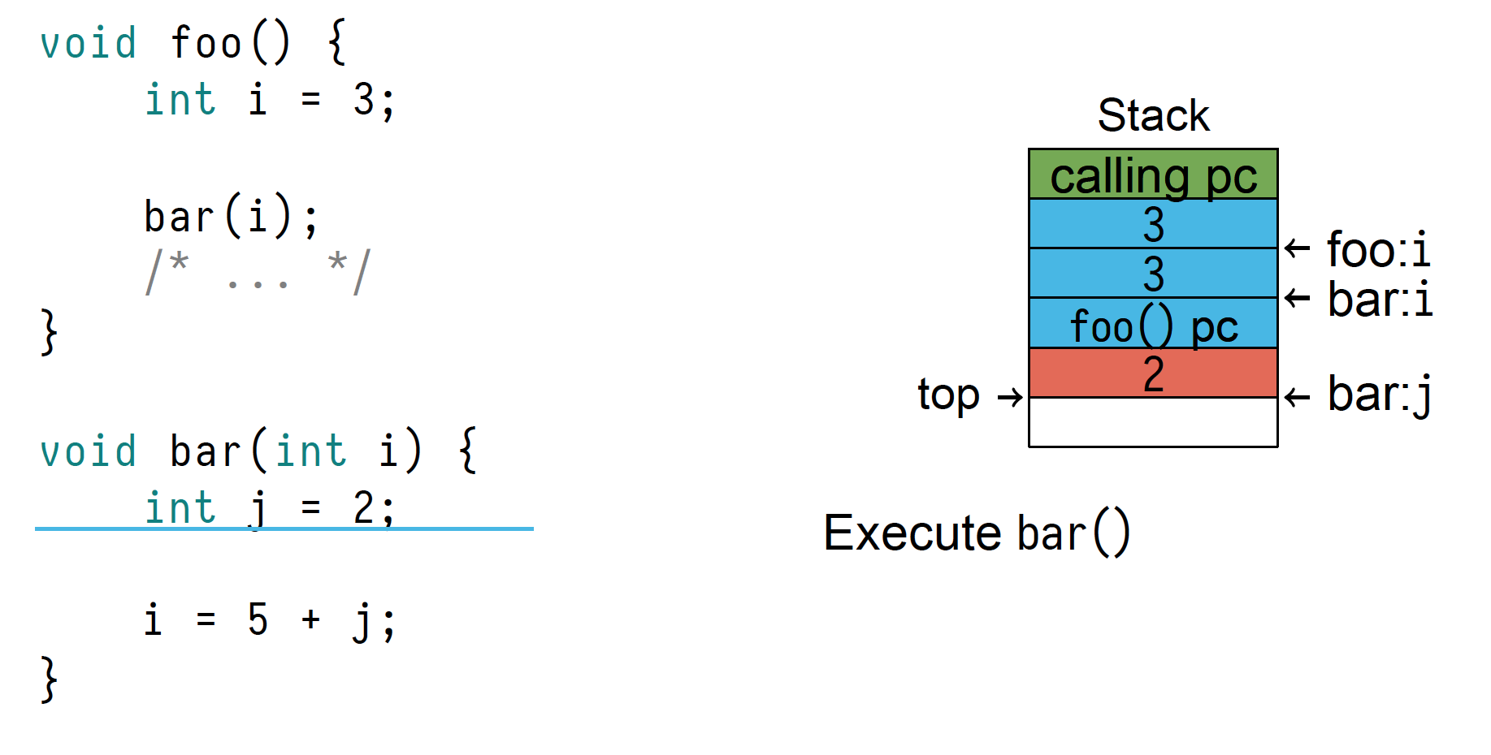
Stack Frame: Example

Slide 43
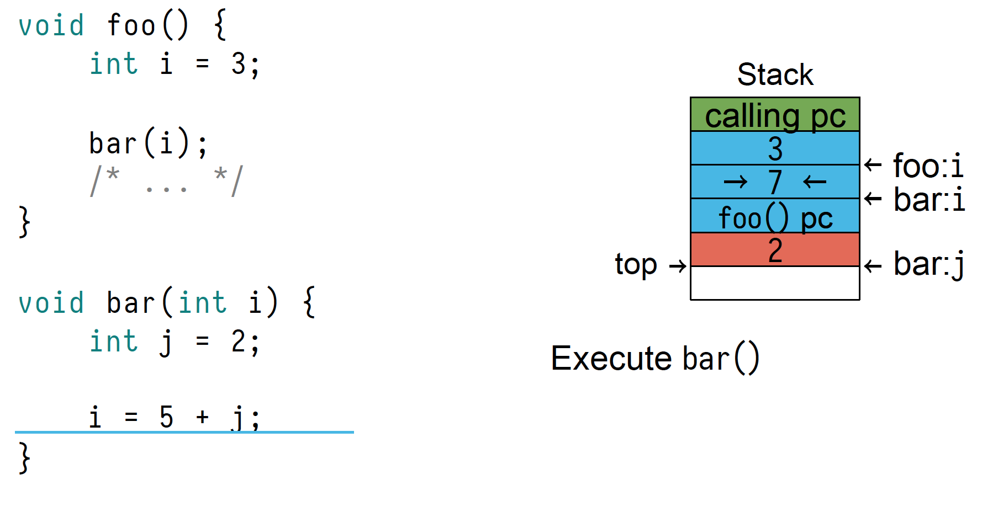
Stack Frame: Example

Slide 44
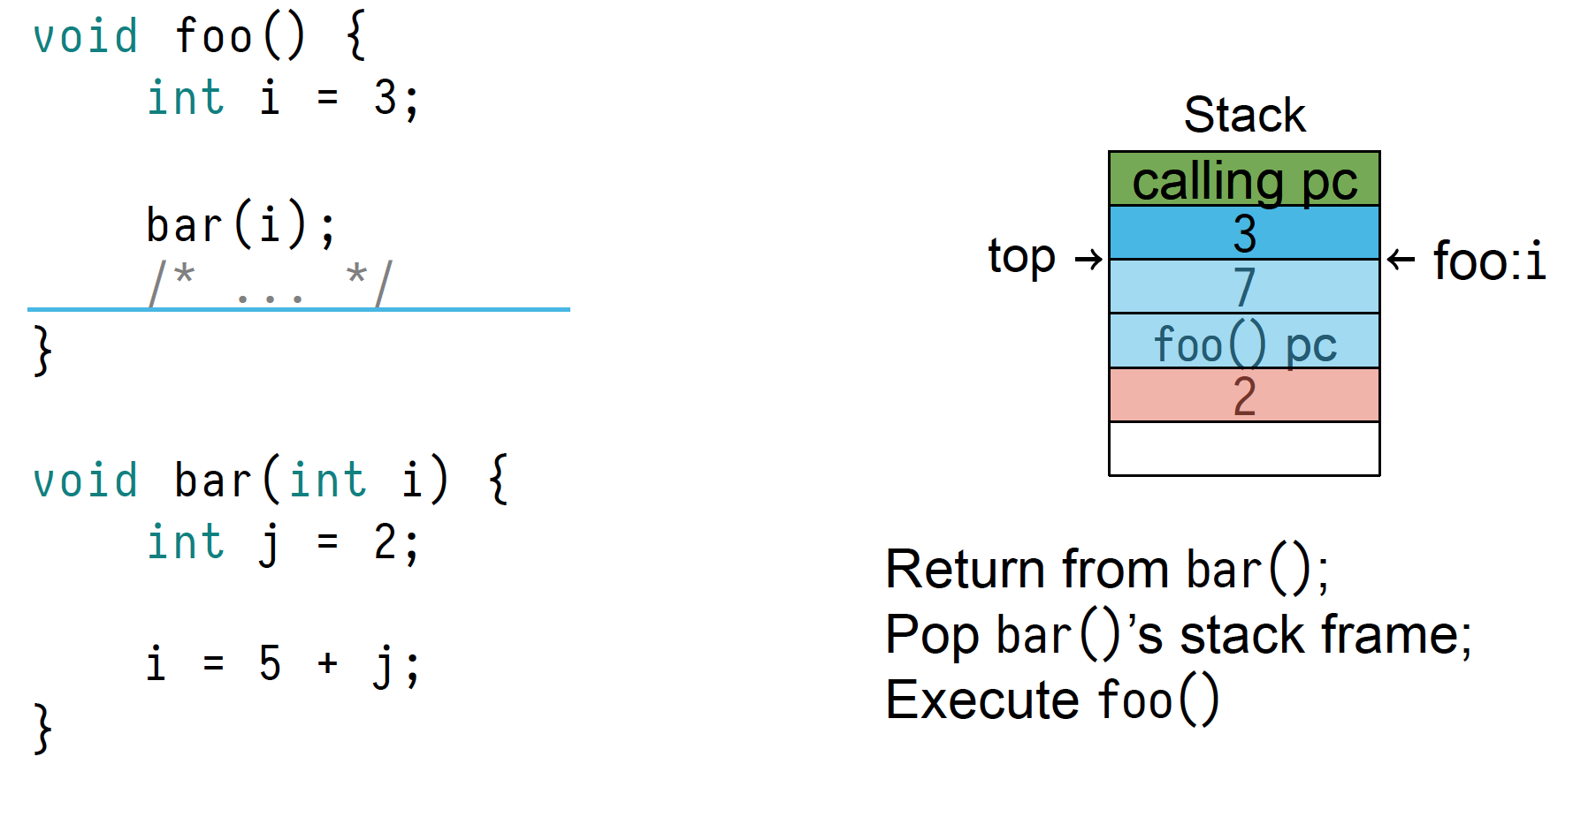
Stack Frame: Example

Slide 45
Summary
POSIX programs are laid out in sections
The stack is a section
The stack grows downward
Automatic variables are allocated on the stack
Stack frames track function calls
Items removed from the stack are not cleared
Stack-allocated arguments are why C is call-by-value

